Slide 1
Introduction to Calculation Groups in Power BI Desktop
Pedro Reis

Slide 2



About the speaker
Microsoft Data Platform MVP / MCT
Expert Leader Data & AI
Leader of Fabric PBI Portugal Group
Founder www.fabricbi.net
pedroreis@reispm.onmicrosoft.com
https://www.linkedin.com/in/pedrogoncalvesreis/
www.fabricbi.net/

Slide 3
Session Plan
What are calculation groups and why to use them
How to create them
Use cases
Resources & Contacts

Slide 4
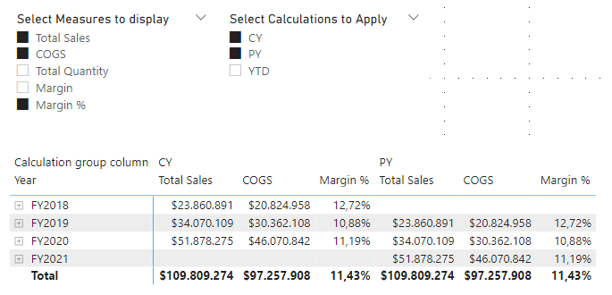
What are calculation groups
Technique to modify context of existing measures and greatly simplify the application of common repeated calculations
Possible create in Power BI via Tabular Editor since July 2020
Can be created directly in Power BI Desktop since Oct 2023

Slide 5
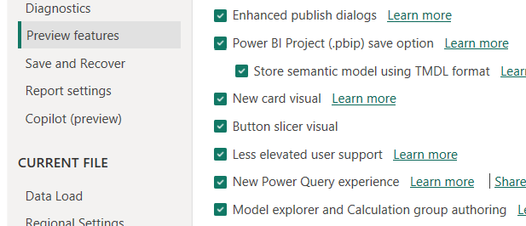
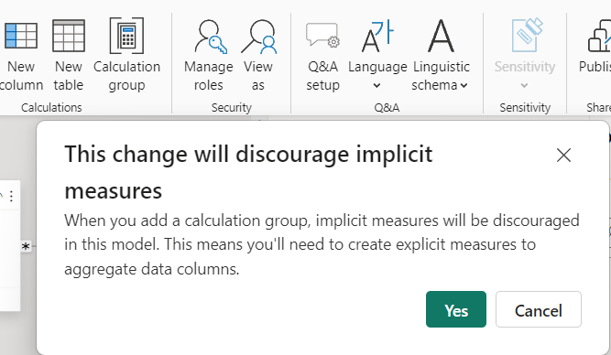
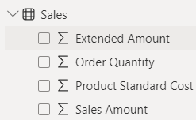

How to create Calculation Groups
If still on Preview, activate it under the preview options
Restart PBI Desktop
On the Model View, Home Tab, click on “Calculation Group” to create a new one
A popup will appear, and upon clicking yes, all implicit measures will be deactivated (all measures with E sign by default available in the model according to the data type), and from that point on you need to create explicit measures (defining the formula with DAX)

Slide 6
Demo
Creating your first Calculation Group

Slide 7
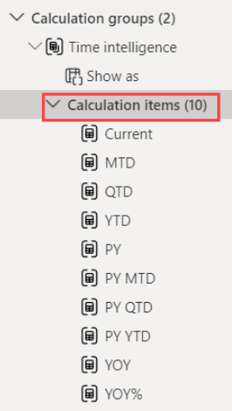
Use cases
Time Intelligence (PY, YTD, YOY, YOY %,...)
Scenarios (vs Budget, vs Last Year)
Activate a Relationship (Order Date vs Ship Date vs Delivery Date)
Rate Conversion, Forecast
Statistics (Min, Max, Avg, Percentile)

Slide 8
Demo
Other Applications of Calculation Groups

Slide 9

Resources & Contacts
Resources
Create calculation groups in Power BI (preview) - Power BI | Microsoft Learn
Deep dive into the Model Explorer with calculation group authoring and creating relationships in the properties pane | Microsoft Power BI Blog | Microsoft Power BI
Contacts
pedroreis@reispm.onmicrosoft.com
https://www.linkedin.com/in/pedrogoncalvesreis/
www.fabricbi.net/

Slide 10















